Slide 1
WHAT IS DATA STRUCTURE?
A data structure is a group of data elements that provides the easiest way to store and perform different actions on the data of the computer.
A data structure is a particular way of organizing data in a computer so that it can be used effectively.
The idea is to reduce the space and time complexities of different tasks.

Slide 2
Need for Data Structures
As applications are getting complexed and amount of data is increasing day by day, there may arise the following problems:
Processor speed
Data Search
Multiple requests

Slide 3
Advantages of Data Structures
Efficiency: Efficiency of a program depends upon the choice of data structures.
Reusability: Data structures are reusable, i.e. once we have implemented a particular data structure, we can use it at any other place.
Abstraction: Data structure is specified by the ADT which provides a level of abstraction.

Slide 4
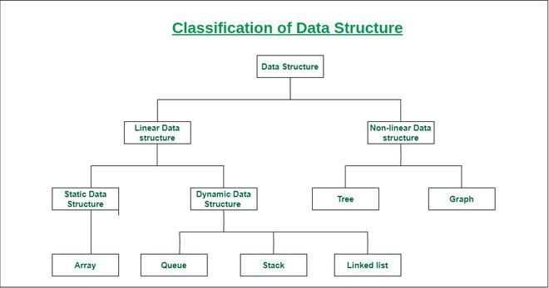

Slide 5
Complexities of an Algorithm
The complexity of an algorithm computes the amount of time and spaces required by an algorithm for an input of size (n).
The complexity of an algorithm can be divided into two types. The time complexity and the space complexity.

Slide 6
Time Complexity of an Algorithm
The time complexity is defined as the process of determining a formula for total time required towards the execution of that algorithm. This calculation is totally independent of implementation and programming language.
Space Complexity of an Algorithm
Space complexity is defined as the process of defining a formula for prediction of how much memory space is required for the successful execution of the algorithm. The memory space is generally considered as the primary memory.

Slide 7
Asymptotic Notations in Complexity Analysis of Algorithms
There are mainly three asymptotic notations:
Big-O Notation (O-notation)
Omega Notation (Ω-notation)
Theta Notation (Θ-notation)

Slide 8
1. Theta Notation (Θ-Notation):
Theta notation encloses the function from above and below.
Since it represents the upper and the lower bound of the running time of an algorithm, it is used for analyzing the average-case complexity of an algorithm.

Slide 9
2. Big-O Notation (O-notation):
Big-O notation represents the upper bound of the running time of an algorithm.
Therefore, it gives the worst-case complexity of an algorithm.

Slide 10
3. Omega Notation (Ω-Notation):
Omega notation represents the lower bound of the running time of an algorithm.
Thus, it provides the best case complexity of an algorithm.

